Slide 1

Cowfold Parish Council
Councillors
Peter Harsum
Sarah Payne
Kate Howell
Mick Clark
Felicity Thorpe
Olivia Bennison
Paul Dittmer
Vacancies x 2
Chair – Steve Reading
Vice Chair – Connie Towle
Clerk – Trevor Parsons

Slide 2

Cowfold Parish Councillors
All our councillors are unpaid volunteers from the community
Councillors are democratically elected every 4 years, next elections are planned for May 2027
We currently have 2 vacancies

Slide 3
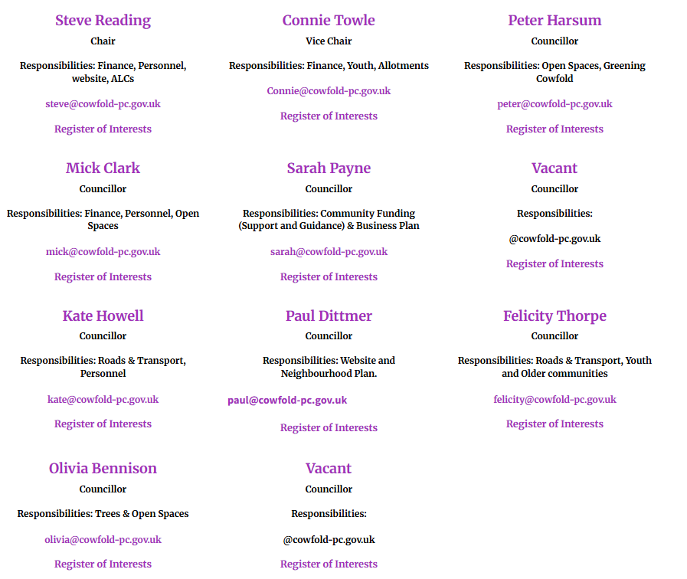
Councillors

Slide 4
Cowfold PC is responsible for
Allotments
Bus Shelters
Local youth projects
Litter picking
Open spaces
Street lighting
Traffic calming measures
Recreational facilities
The Allmond Centre

Slide 5

Horsham District Council is responsible for:
Waste collection
Car Park management
Parking enforcement
Housing and homelessness
Planning applications
Council Tax collection (in partnership with LGSS)
Parks and Countryside
Licensing
Environmental Health
Building Control
Councillors:
Joanne Knowles
Lynn Lambert

Slide 6

West Susssex County Council is responsible for:
Schools
Roads, highways and verges
Social care and public health
Waste disposal
Libraries
Births, marriages and death
Public Rights of Way
Councillor
Sarah Payne

Slide 7
Current Issues
Speed Working Group
  Serious Accident Review underway by WSCC – latest indication is that results & recommendations will be published mid year 2026
  Application for zebra crossing on A272 Mercers Mead to Playing Field was submitted June 2025. Decision by WSCC has been delayed into 2026 pending the results of the Serious Accident Review.
  Cowfold Parish Council actively investigating 3 new speed monitors (West on A272; North on A281; South on A281)
Path on Playing Field (Playground to Scout Hut)
  Plans being drawn up

Slide 8
Current Issues
Playing Field
  We are looking for support from Football Foundation for improvements to maintenance of our Adult and Youth Football Pitches
  Pitch fees
  Path from Car Park to Scout Hut
Impact of Devolution
  Some issues already being transferred from HDC to Cowfold PC (eg Playground Inspections)
  Asset ownership (eg car park; land in Holm Oaks)

Slide 9
Current Issues
Cowfold Neighbourhood Plan
  Is now approved and in force
  Active for 5 years
  Review required – working group to be set up in 2026 – volunteers from the community needed
Infrastructure Development Plan
  Is now approved and in force
    Transport & Accessibility
    Digital & Utility Infrastructure
    Community Facilities
    Green & Environmental Infrastructure

Slide 10

Tree Surveys
What are they?
A hazard evaluation survey carried out by a qualified arboriculturist on all the trees owned by the landowner.
The survey is carried out on a ‘negative reporting’ basis, whereby only details of those trees requiring works are recorded, with consideration given to the locations of the trees and the likelihood that they would cause damage or injury were they to fail.
Why?
In the UK, landowners have specific legal obligations regarding trees, particularly when it comes to tree surveys
Local authorities have a duty of care to ensure that trees don’t pose a risk to people/ property on public / high risk land.
Failing to manage tree risk can lead to injury, insurance claims, and legal action under the Occupiers’ Liability Act 1957/1984
This is not something that Cowfold Parish Council have previously been doing.
The condition of trees on land owned or managed by the Council, can, if in poor condition, pose a number of risks to the council.
Our aim as a council is to keep as many trees as possible and preserve them so they remain healthy and long lasting.
Tree surveys detail all recommended works with time scales that the works should be carried out.

Slide 11
Current Issues - Renewables
Rampion 2 Offshore Windfarm
  Secretary of State’s decision 4th April 2025 to proceed
  New substation at Oakendene near Cowfold with final connection into transmission network at Bolney
  Disruption to residents
  Loss of vegetation & habitat
  Potential to apply for grants to benefit the community (max £20k with positive environmental impact)
  CPC aim to be proactive to minimise disturbance to the community
Potential Solar Farm North Cowfold (Picts Lane)
  New proposal by EDF Renewables
  South Lodge Estate
  Online Survey by EDF https://edf-re.uk/our-sites/pictslane
  Still at design stage but EDF have engaged with local residents and stakeholders
  Planning permission not yet applied for
Cobwood Solar Farm
  Planning consent already approved, construction underway

Slide 12
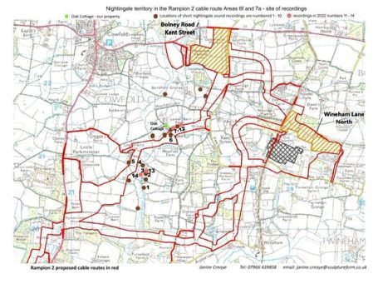
Rampion 2

Slide 13
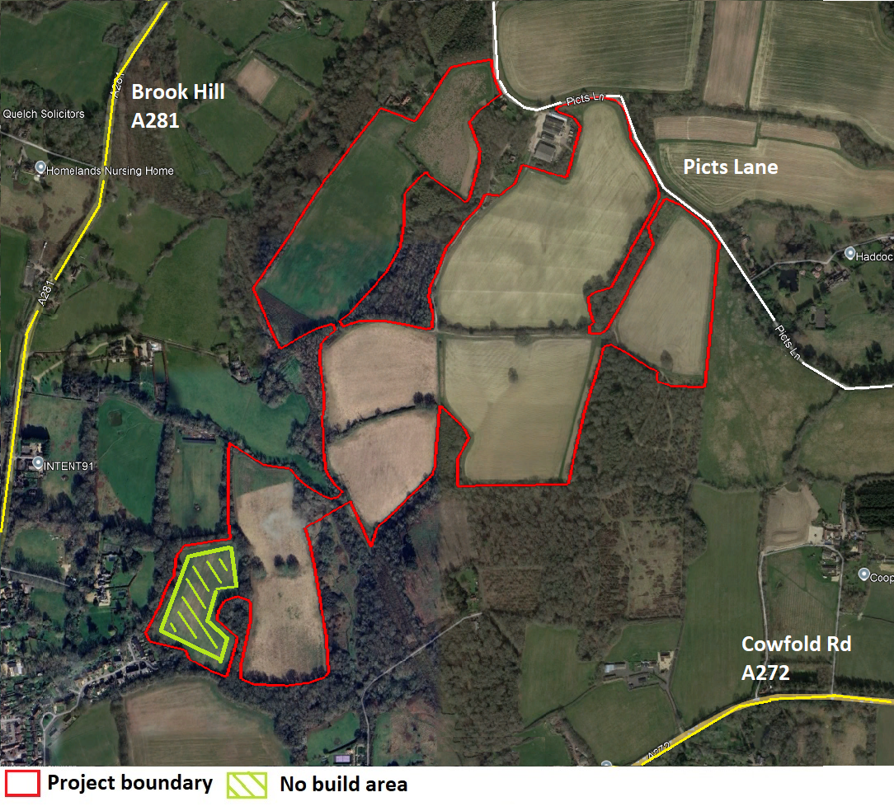

Slide 14
https://www.cowfold-pc.gov.uk
Our website has recently been updated
Now easier to navigate
Meetings, Minutes and Agendas
Contact Details
  Email addresses, specific areas of responsibilities for Cowfold Parish Councillors
  Also contact addresses for Horsham District Councillors and West Sussex Councillor
Finances
  Outline and explanation of Cowfold Precept
  Copies of Financial Reports
  Grant application form

Slide 15
Cowfold Parish Precept
What is the Parish Precept?
The Parish Precept is the portion of Council Tax collected specifically for the Parish Council. It is our main source of income and is collected on our behalf by the local authority.
What is the Precept Used For?
The precept pays for local services and responsibilities, including:
Maintenance of parish buildings, land, and assets
Grounds maintenance and environmental work
Community projects and local initiatives
Insurance, utilities, and professional fees
Meeting legal and statutory obligations
These services directly benefit the local community.

Slide 16
2026/7 Precept
Why Has the Precept Increased This Year?
Over the past couple of years, the Parish Council has used financial reserves to keep increases to a minimum. Reserves are limited, one-off funds and cannot be relied upon to fund ongoing annual costs.
Those reserves have now reached a level where they must be protected to ensure:
Financial stability
Emergency and unforeseen repairs
Delivery of planned future projects
As a result, the precept has been set to reflect the true cost of providing parish services in a sustainable way.
How Much Will The Precept Increase from April 2026?
The Band D Parish Council charge has increased from £94.80 to £119.92, which is an increase of 26%.

Slide 17
2026/7 Precept
What Does This Mean for My Household?
The approximate weekly cost by Council Tax band is:
Band A: £1.55 per week
Band B: £1.80 per week
Band C: £2.05 per week
Band D: £2.31 per week
Band E: £2.81 per week
Band F: £3.32 per week
Band G: £3.85 per week
Band H: £4.61 per week

Slide 18
2026/7 Precept
Could the Council Have Avoided This Increase?
The Parish Council has carefully reviewed all spending and continues to seek value for money. However, continuing to rely on reserves would not be financially responsible and would risk the Council’s ability to respond to future needs or emergencies.
Will the Precept Continue to Rise?
The Parish Council reviews the precept annually. Any future changes will depend on service costs, inflation, and community needs. The Council remains committed to keeping increases as low as possible while maintaining essential services.
Where Can I Find More Information?
Further details, including budgets and meeting minutes, are available on the Parish Council website or by emailing the Parish Clerk on clerk@cowfold-pc.gov.uk

Slide 19
2026/7 Precept vs Other Rates
HDC published increase 2.94%
WSCC and Police not yet finalised, but assume 4.99% (as per WSCC proposal)
Cowfold precept would still remain a small proportion of the total rates bill.
Amounts to less than 5% of total rates bill.

Slide 20
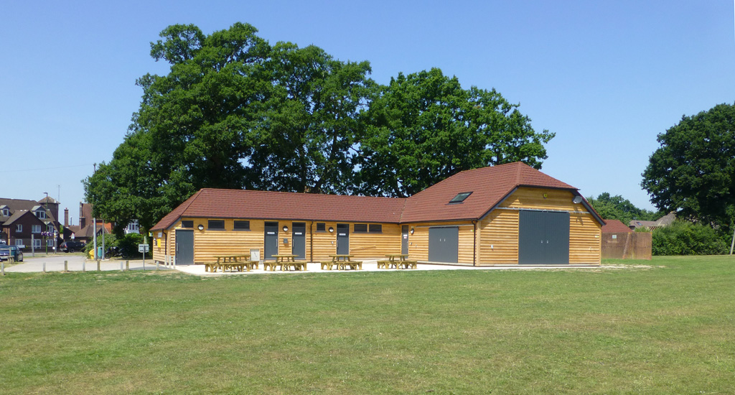

Allmond Centre
Great facility for the village
  Sporting Events
  Conferences
  Parties
Available from 8am to 11:30pm
Community area and kitchen / bar
  Residents £16 / hr
  Non residents £23 / hr
  All bookings require an additional £20 cleaning fee
Changing Rooms
  Prices available on request
Any questions please contact connie@cowfold-pc.gov.uk
Or visit www.the-allmond-centre.lemonbooking.com

Slide 21

Our Allmond Centre
Great facility for the village
But bookings are down
Costs are rising
We want to make it more accessible for the whole community
Camelia Botnar have been engaged to redecorate – students under supervision providing work experience & with donations from Crown Paints
The Parish Council are looking at ways to make it a Community Hub

Slide 22

Our Allmond Centre – A Community Hub
Some of the suggestions we have already received:
Partnership with Age UK
  Social Inclusion & Loneliness Programmes
  Digital Inclusion Classes
  Exercise Classes
  Mental Health Support
  Crafts and Creative Arts
Health Talks
  Healthy Eating
  Vaccination advice
Antenatal & Mother and Baby Groups
Young Persons Workshops
  Finance Awareness
  Career talks
Table-top spring-clear out sales
5k fun-run base
Please add your ideas on the Post It note…
Alternatively complete our questionnaire

